Slide 1
The European social dialogue and the development of the solidarity between generations of workers: focus on “over 55” and young workers in the finance sector. Sustainable Growth and generation gap VS/2018/0040
THE TRAINING COURSE
OUTCOMES
Paola Vinciguerra
FIRST , National Training Officer

Slide 2





The action general aims
From a theoretical point of view
to prove that
the most effective response to demographic changes is taking care of the ageing working population through
Age Management policies
and
Intergenerational solidarity

Slide 3
The action general aims
From an operational point of view
to identify a "virtuous circle" between European, national and company trade unions
to negotiate companies policies for aged and young workers in order to manage changes in work in a supportive and inclusive way

Slide 4

Expected results
Good practice analysis and empirical research
RESULTS’ DISSEMINA TION
Context analysis and scientific research
TRAINING ON THE TOPICS
Strengthening TU role for effective industrial relations
Foster synergies b/w Eur, national, company trade unions
to identify a "virtuous circle" between European, national and company trade unions to negotiate companies policies for aged and young workers in an INCLUSIVE WAY

Slide 5
The project structure
KICK OFF
Valencia
May
17-18
2018
RESERCH
& DISTANCE
WORK
Virtual agorà
Jun 2018-Jan 2019
WORK SHOP
EUROFOUND
Dublin
15 March 2019
STEERING COMMITTEE MEETING
CEDEFOP
Thesseloniki
11 June
2019
STEERING COMMITTEE MEETING
CRACOW
11 OCTOBER 2019
TRAINING COURSE
Rome
18-19
September
2019
MEETING
TO SHARE RESULTS AND BUILD UNITARY DOCUMENT
Budapest
12 feb
2019
FINAL CONFERENCE
VICO
3 DEC 2019
2 YEAR LONG PROJECT

Slide 6

The Training aims
Improve knowledge on the EUROPEAN SCENARIO and the MAIN POLICIES of
intergenerational solidarity
EXCHANGE EXPERIENCES
among partners on their company systems
Reinforce the participants’ awareness of their role of AGENTS OF KNOWLEDGE & CHANGE.
ROMA 18-19 SEPTEMBER 2019

Slide 7

THE TRAINING GENERAL GOAL
To help participants develop a specific sensitivity and innovative tools:
to negotiate COMPANY COLLECTIVE AGREEMENTS based on workers' needs by age and personal situation
to manage, monitor and evaluate company policies based on AGE PLANS.

Slide 8

THE TRAINING AIMS
1. TRAINING AIMS ON KNOWLEDGE
Improve participants' knowledge on:
the European legislative framework on intergenerational solidarity and age management in the workplace
the scenario and possible future development in the European financial sector due to the impact of digitalization and demographic changes in the labour market
the main types of intergenerational solidarity policies (glossary) and a COMPANY AGE PLAN objectives and tools

Slide 9

THE TRAINING AIMS
2. TRAINING AIMS ON CAPACITY BUILDING
To strengthen participants' awareness of their role as agents of change through the acquisition of innovative negotiating and social dialogue tools (AGE PLAN AND BILATERALITY)
To develop their competence:
  To build NEGOTIATION ACTION PROTOCOLS on intergenerational solidarity, identifying the most appropriate tools and policies for a company/group context.
  to support the creation a negotiated, inclusive and supportive system of company services for the employees

Slide 10


METHODOLOGY
inductive and participatory
IN 3 STEPS
Identify workers’ needs - set up a TU platform on AGE PLAN - Collective agreement’s management, monitoring and evaluation
TARGET GROUP
24 trade unionists experts in company bargaining coming from leading companies in the finance sectors of the project partners countries

Slide 11
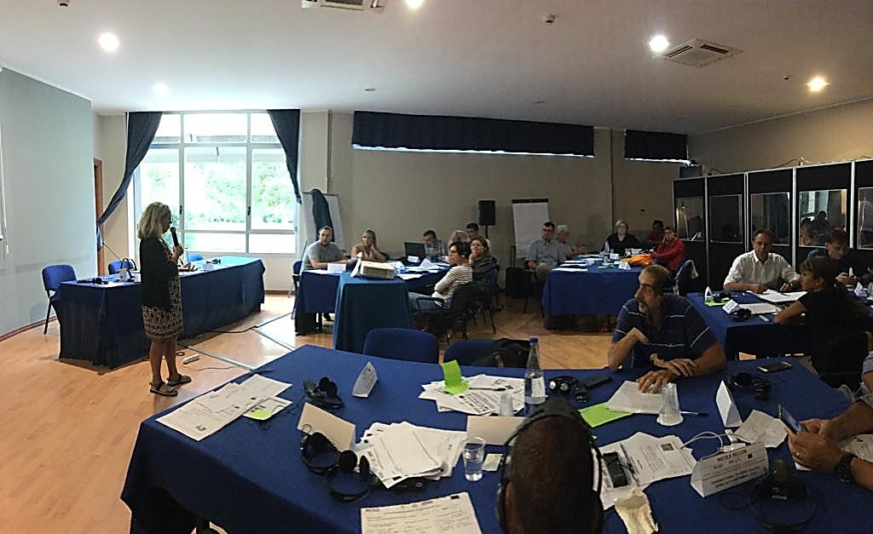
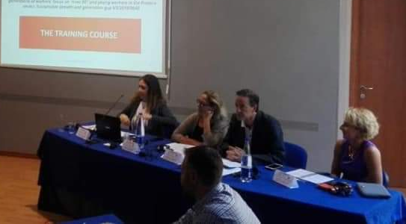
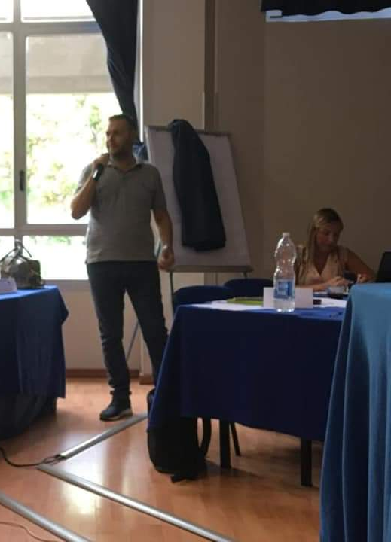
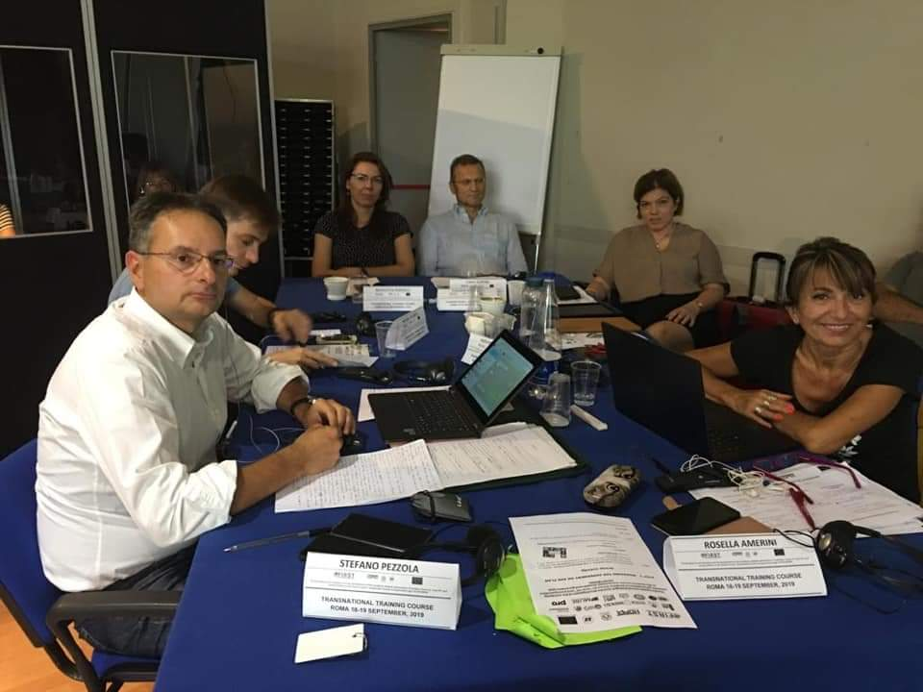
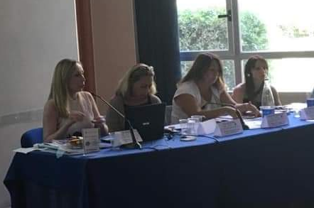
Training in action

Slide 12



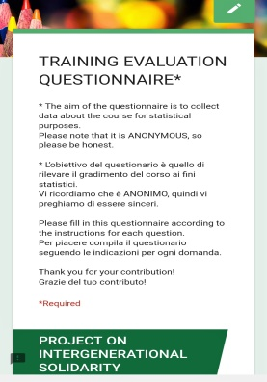
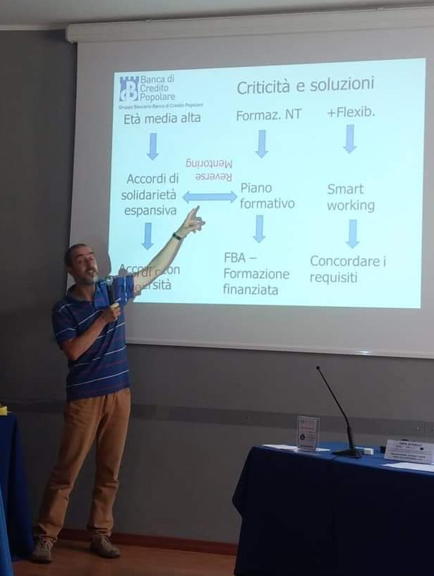
Training evaluation system
1. reaction
On line training evaluation questionnaires
2. learning
during the training (group activities & observations and debate )
3. behaviour
Work methods implementation
4. results
Negotiation initiatives on intergenerational solidarity
the Dissemination activity
KIRKPATRICK MODEL

Slide 13

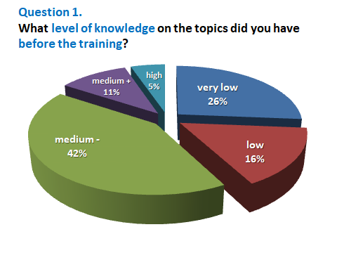
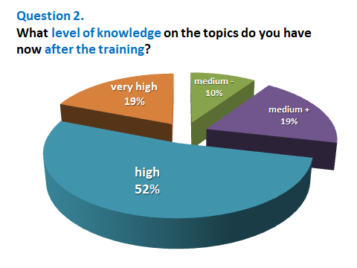
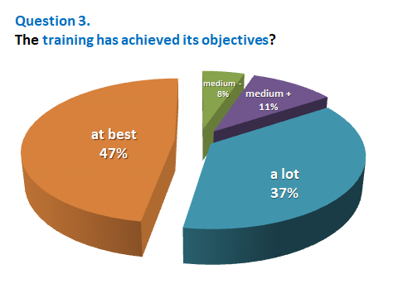
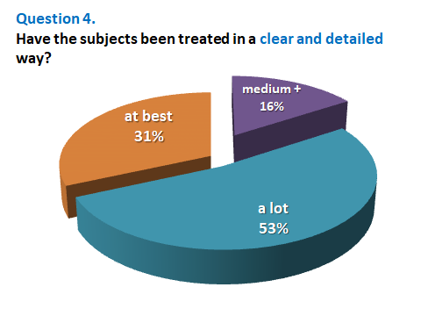
1. reaction
Participants’ evaluation

Slide 14
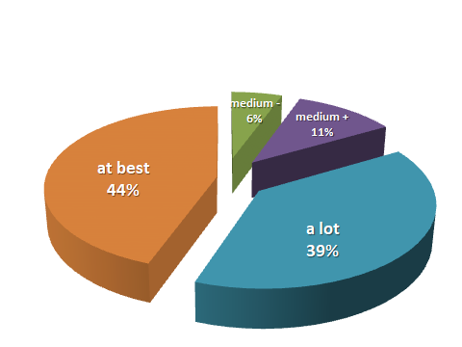
Question 5.
Do you think that the topics are USEFUL to your role in the TU? Why?
1. reaction
Participants’ evaluation
Topics discussed are common especially flexibility , generational gap issues, social demands and workers expectations
the age plan management because I didn't have any information of it before the course
possible ways to keep older colleagues at work, as an alternative to displacement, which is the only form proposed by the banks
Workers' age in EU, ways to deal with the issue.
What factors are interesting to motivate the employees.
Realizing the importance of carrying out intergenerational policies in companies

Slide 15
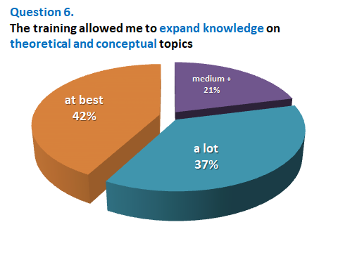
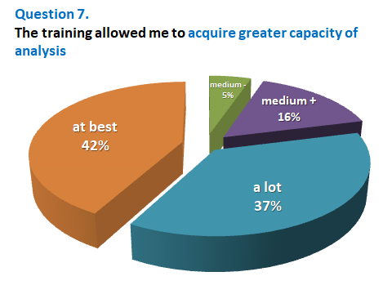
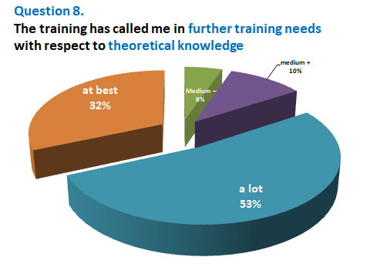
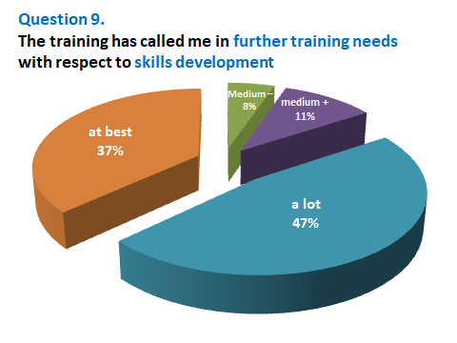
1. reaction
Participants’ evaluation

Slide 16
1. reaction
Participants’ evaluation
What kind of further TRAINING do you need?
European legislation
Specific national regulations
Methodology of negotiation, managing expectations and evaluating results
Developing digitalisation and how is this going to impact our lives.
the understanding and raising awareness on intergenerational solidarity topic will be fundamental for the protection of the working future of the sector
Deepen the institutions to be able to propose
pension
Negotiations on age planning
Playing presentation
How to include this kind of policies in collective agreement

Slide 17
1. reaction
Participants’ evaluation
What PROGRESS did the course allow you to make?
Better negotiating skills, broader ideas that come from shared experiences can be taken on board and adapted .
Awareness of the reality in the company at European level.
Speak about the subject with my young colleagues, make them aware of the impact of aging and take measurements for this.
Identify the ageing workforce issue in EU level + discuss ways on how to deal with the issue.
To give information to HR about the international circumstances and what ideas were told which could be adapted for solution.
To identify the same problem in other European countries, and try to get common approaches based on best practices
Overall to be able to see this issues from a different perspective

Slide 18
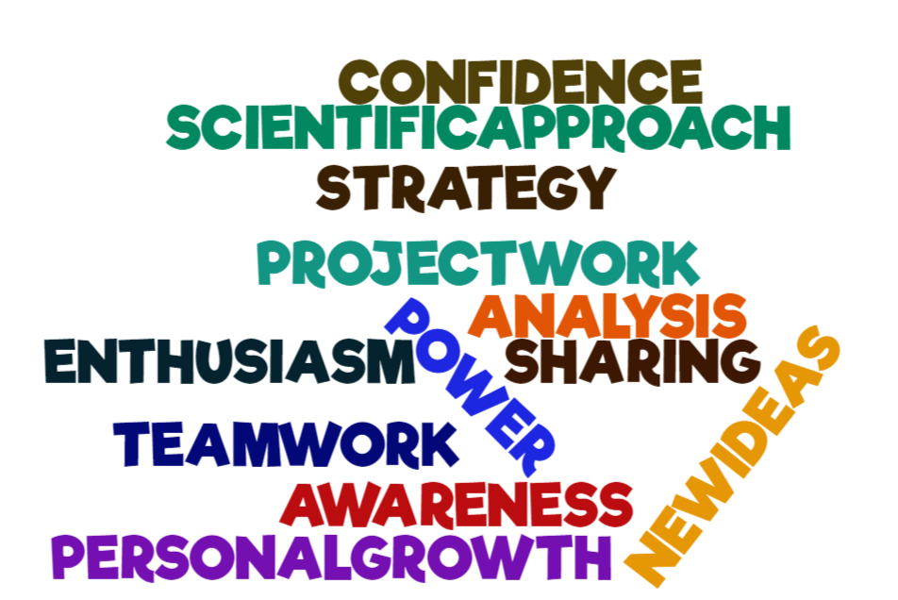
1. reaction
Participants’ evaluation
What PROGRESS did the course allow you to make?

Slide 19


1. reaction
Participants’ evaluation
What did you like?
What you DIDN’T like?
Interacting with bankers from different nationalities all determined to contribute to this very necessary cause
Sharing experience, gain experience and receive good ideas that could be implemented in my company.
International environment & language working group
Atmosphere, team-working, networking.
the group activity in separate groups and finally the comparison between the results of the groups.
The contributions from the scientific partners
Venue position and food
I would have liked the testimony of someone who had already dealt with agreements on Age plan
I'd rather have looked into any relevant draft legislation

Slide 20

1. reaction
Participants’ evaluation
87%
The average level of satisfaction

Slide 21
2. learning
1. reaction
Learning outcomes
The participants well succeeded in increasing:
their knowledge of the EU legislative framework , the demographic scenario and the ETUC position on the issue
Their confidence in applying the difference policies on intergenerational solidarity (GLOSSARY)
their knowledge and skills on how to build, manage, monitor and evaluate a COLLECTIVE AGREEMENT based on AGE PLAN
Their expertise on innovative contractual instruments based on worker needs and the context analysis
their awareness on a trade union culture based on solidarity, participation and bilaterality

Slide 22
The European social dialogue and the development of the solidarity between generations of workers: focus on “over 55” and young workers in the finance sector. Sustainable Growth and generation gap VS/2018/0040
Grazie

