Slide 1
Right to disconnect

Slide 2
Where did it all begin…
Recent years shift in the way people work (teleworking, e-commerce, platform economy)
Government made a ‘labour deal’
Objective:
to reform labour law to respond to these new ways of working while allowing more flexibility for both employers and employees, while ensuring a better work-life balance;
raise the employment rate to 80% by 2030.

Slide 3
Labour deal and right to disconnect
By the 31st of March 2023
companies with more than 20 employees
must conclude agreements on the right to disconnect (through a collective agreement or an amendment to the ‘règlement de travail’)
The purpose of introducing a right to disconnect for the worker is twofold: to ensure that rest periods and leave, as well as the worker's private and family life, are respected.

Slide 4
Labour deal and right to disconnect
The agreement must (at least) provide for:
the modalities for applying the right to disconnect
the guidelines for the use of professional digital tools
the training and awareness-raising actions set up to prevent any unreasonable use of these tools and the risks that may result

Slide 5
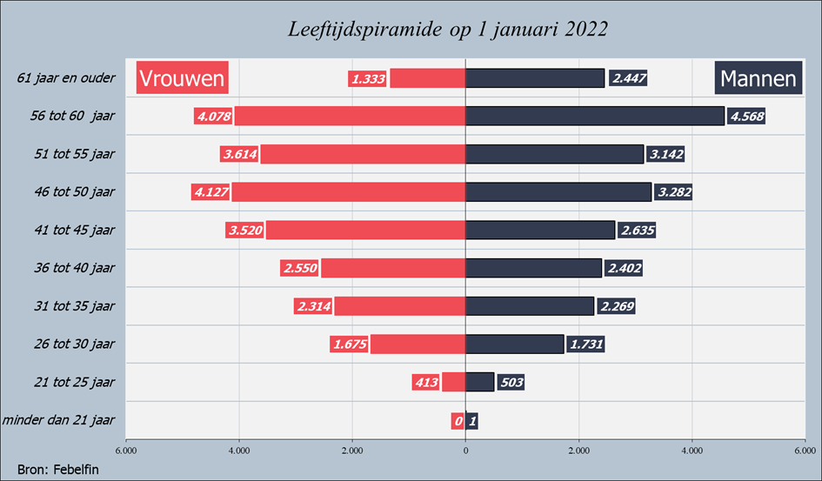
Belgian bankingsector
80 banks: different types
46.604 employees (These are not employees working at an office run by an independent contractor) Vs 2010: 58.475
average age of 47.06 years (vs 2010: 43,84) 41+ = 70% / 51+ = 41%
average seniority of 19.4 years (vs 2010: 18,31)
M = 49,3% / F = 50,7% (vs management: M = 72,2 / F = 27,8)
Fulltime = 74% / Parttime = 26%
Type bank | % employees
‘Big bank’ | 73%
Retail bank | 15%
Private bank | 7%
Specialised | 3%
Entrepreneurs' bank | 1%
Credit provider | 1%
Notes:
Large banks: these are banks that offer a wide range of services and products, serving as many different types of consumers (retail customers, private banking customers, entrepreneurs, etc) as possible. They include BNP Paribas Fortis, KBC Bank, Belfius Bank and ING.
Private banks: these are banks with specific offerings for wealthy customers. Examples include Bank Degroof Petercam or Delen Private Bank.
Entrepreneurial banks: these are financial institutions that focus on entrepreneurs. Bank J. Van Breda is an example of a bank for entrepreneurs and liberal professions.
Retail banks: these are banks with offerings aimed at retail customers. Argenta, Beobank, Crelan are examples.
Lenders: these are financial companies that focus specifically on lending and offer little or no other services. CKV bank and Record Credits are examples.

Slide 6
Bankingsector
We concluded a supplementary collective bargaining agreement: it applies to those companies without company agreements
What’s in it?:
Right to disconnect =
the employee's right not to be logged on to his professional digital tools outside the agreed working hours. exceptions are: - employees performing a critical function; - other agreements have been made with the employee in advance; - force majeure.
The commitment that employees refrain from taking contact with their colleagues outside working hours, during rest periods, holidays, leave and suspension of employment.

Slide 7
Bankingsector
Analysis and prevention
The analysis of the risk of overconnection and its prevention is part of the company's obligations in terms of well-being at work and prevention of psychosocial risks

Slide 8
Bankingsector
Practical terms and guidelines
not contacting colleagues outside normal working hours
The employee cannot be disadvantaged if he ‘uses’ his right to disconnect
make team-by-team arangements
planning holiday periods in good time and preparing them well together with your manager
Keep your diary up-to-date

Slide 9
Bankingsector
Training and awareness actions for employees and managers
include training in the sectoral training offer
The company will organise regular information and awareness campaigns for managers and all employees
Managers engage in the conversation within their team around work-life balance
Periodically, the situation is assessed and placed on the agenda of social dialogue

Slide 10
It is an important and relevant topic
Goal: initiate debate with employees and reach concrete agreements
Observation: increased connectivity (and working more from home) often leads to stress, fatigue and unwellness.
Some figures: - 50% of employees are often or always reachable after working hours - 60% of employees handle emails after working hours - only 20% of employees are NOT reachable after working hours

Slide 11
Getting started…
How do employees experience work-life balance?
Huge blurring of boundaries
How do we deal with this consciously?
Important for individual work experience and job satisfaction
Important to look for collective solutions together with employees

Slide 12
Guidelines/tips/Negotiations
Basis is legislation on working time
Find the right balance between setting limits and autonomy
Make an analysis of the reality in your company and ensure involvement of the employees
Take into account the legislation on prevention of psychological risks
Notes:
Philippe zei dit al!

Slide 13
What to include in negotiations?
Determine causes and not just consequences - context! Work organisation – workload - company culture
Make an analysis of the current situation – what are the habits?
Determine ‘normal’ working hours
Describe what is ment by ‘right to disconnect’ - right not to perform work out of ‘normal hours’ - right not to be adversely affected - duty for everyone to respect the right

Slide 14
Right to ‘recovery time’ (hersteltijd) – How to stay fit and energetic? - allways ‘on call’ has negative effect on wellbeing - integrators vs segmentators - importance of knowing your own boundaries well and communicate them
Training and support for managers
Clear communication, education and support - why is it important to disconnect - employee training - technological solutions
Right to disconnect vs autonomy

