Slide 1
MiFID II and digitalisation: Changes in the organizational models in the banking sector
Lucia Kováčová, CELSI
6.3.2020

Slide 2
Structure of the presentation
Key findings of the literature review about impact of the MiFID II and digitalization on organizational models
Survey of workers
Survey of social partners
Case studies (Slovakia, Austria, Finland, Italy)

Slide 3
Key findings of the literature review
Digitalisation and MiFID II regulation brought substantial changes in the internal control and governance in the EU financial sector
Demand for transparent process of product approval, tackling conflict of interest, thus, fostering investor protection
Clients' interests are placed in the center
Digital transformation is intertwined with new skill requirements and novel behavior of clients
The role of banks and investment firms is gradually changing: new types of services, broader cooperation with FinTech companies, novel customer relations
Introduction of new technological solutions: novel communication channels (online support and guidance), advanced data analytics and regulation of data providers (data mining, gathering storing and sharing), new rules on algorithm trading, blockchain technology, eco-friendly solutions

Slide 4
Key findings of the literature review
Changes in the internal structure: cooperation with external entities (FinTech companies, data providers, etc.), investing in own research as an ancillary service, enlargement of Compliance and IT departments
Skill demands: ESMA Guidelines for EU member states, demand for digital skills, standardization of methods of work, changing social interaction channels, responding to clients' needs more effectively and promptly
Expectations: more effective and prompter product approval, clients are supposed to be more self-sufficient in making financial decisions,, higher responsibility of financial institutions, increased ability of clients to work with multiple financial institutions, changing skill demands, personalization of goods and service provision

Slide 5
Survey of workers
Dissemination period: by the end of June 2020
Survey of workers in the banking sector (employees, self-employed, contractors, etc.)
In cooperation with research partners and Wage Indicator
Translated in the all EU languages
Divided into three areas: (1) Organisational changes and skill management; (2) types of contracts; (3) working conditions and OSH
Italian and Slovak Survey (to be demonstrated):
https://iltuosalario.it/carriera/questionario-per-i-lavoratori-le-condizioni-di-lavoro-nel-settore-del-credito
https://mojplat.sk/kariera/zmena-zrucnosti-zamestnancov-v-banke

Slide 6
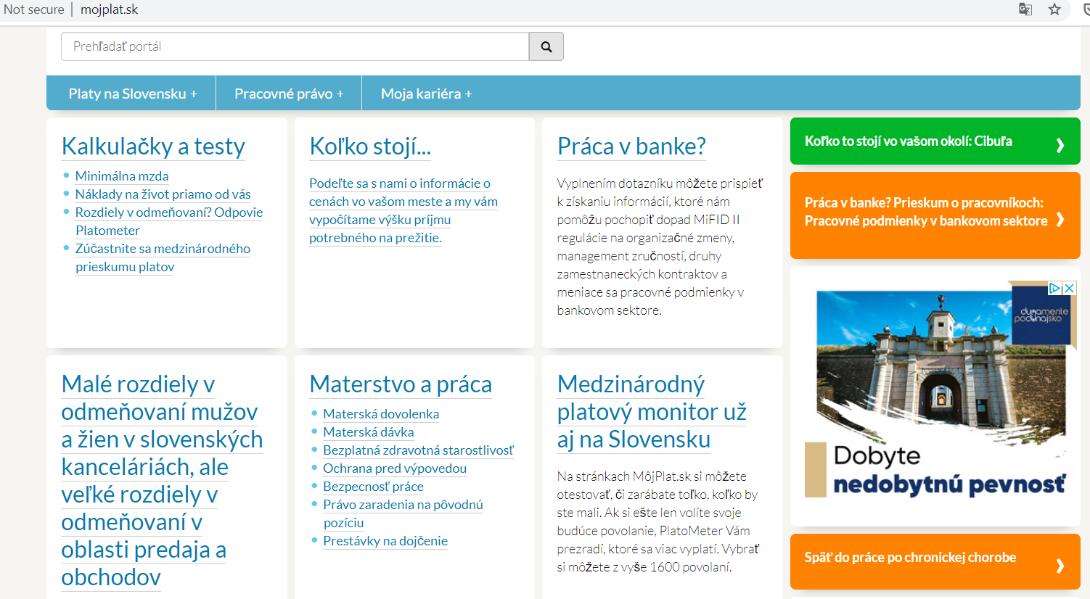
Survey of workers

Slide 7
Survey of social partners
Dissemination period: by the end of June 2020
Survey of social partners in the EU countries
Questionnaire divided into three sections: (1) Background information; (2) Organisational changes and the skills management; (3) Contracts and Working conditions
Only English version
Disseminated in cooperation with Wage Indicator and other project partners

Slide 8
Case studies
Time-frame: March – April 2020
Semi-structured interviews with at least five respondents (social partners) in Slovakia, Austria (both CELSI), Finland (FIOH) and Italy (ADAPT)
In-depth exploration of the impact of digitalization and the MiFID II regulation on working conditions, OSH, organizational changes, skills management
Unified Interview Guide with a couple of country-specific questions

Slide 9
THANK YOU FOR YOUR
ATTENTION
lucia.kovacova@celsi.sk

