Slide 1
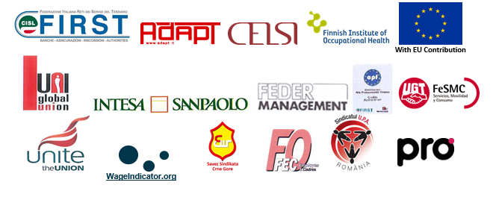
Changes in the financial Labour Market: the impact of Directive 2014/65 (MiFID II) and Digitalization. The key-role of Social Dialogue and Industrial Relations to manage the transition from 'traditional' to 'hybrid' contracts for a renewed protection - VS/2019/0097
THE TRAINING COURSE
AIMS & METHODOLOGY
Anna Masiello
FIRST CISL, National Training Officer
Zoom Meeting 15-16 July 2021

Slide 2
Expected results
IDENTIFY
the finance sector Industrial Relations GUIDELINES
TO GOVERN THE EFFECTS of MiFID II and digitalization
Good practice analysis and empirical research
Results’ dissemination
Context analysis and scientific research
Training on the topics for TU negotiators
Strengthening TU role for effective industrial relations
Foster synergies b/w national, company and EU trade unions

Slide 3
THE TRAINING GENERAL AIM
To strengthen participants' expertise through the acquisition of knowledge on the impact of digitalization and Mifid II Directive on financial companies, in order to improve their negotiating effectiveness for the protection of employees in the European banking sector.

Slide 4
THE TRAINING AIMS
At the end of the module, participants will be able to:
Identify contractual action paths to respond to the challenges generated in the European financial sector by digitalisation and Mifid II with regard to:
Labour law and contractual profiles
Work quality and workers’ health & safety in the workplace
Company organisation and demand for work/employability
Increase the awareness of their role as agents of change and knowledge
Exercise and disseminate a trade union culture based on competence, innovation and participation

Slide 5
METHODOLOGY
Virtual classroom
Presentations
Critical reflection activities
Group activities (Zoom rooms)

Slide 6
Agenda 15 July
09:30 Opening
Project presentation
Participants’ icebreaker
Training course introduction
11:00 Coffee Break
Conceptual introduction to the topic – Domenico Iodice
Presentation of research objectives and methodology – Francesco Discanno
The impact of MiFID II and digitalization on labor and contractual profiles in the European financial sector - Adapt
Activity in plenary and debate
13:00 Lunch break
14:30 The impact of MiFID II and digitalization on job quality and H&S in the European financial sector - Finnish Institute of Occupational Health (FIOH)
Activity in plenary and debate

Slide 7
Agenda 16 July
09:15 - 09:30 Connection opening, welcome
09:30 Opening and 1st day recap
The impact of MiFID II and digitalization on company organization and labor demand & employability in the European financial sector - Central European Labour Studies Institute (CELSI)
Activity in plenary and debate
Survey findings on Mifid II perception from expert & practitioner observers - Francesco Discanno
11:00 Coffee Break
Group Activity and debriefing in plenary
The EU project guidelines and policy recommendations - Domenico Iodice
Final evaluation in plenary
13:30 End of the training course

Slide 8
The virtual classroom rules
Connect from a private location
Connect from a quiet place that
encourages concentration
Follow from the beginning to end
Keep the audio muted
Keep the video on (as much as possible)
Use headphones
Raise your hand if you want to speak
Be brief and respect the given time limits when talking
Speak slowly and clear to facilitate interpretation
Leave mobile phones aside
(except when required by teaching activities)
Are you in?

Slide 9
Changes in the financial Labour Market: the impact of Directive 2014/65 (MiFID II) and Digitalization. The key-role of Social Dialogue and Industrial Relations to manage the transition from 'traditional' to 'hybrid' contracts for a renewed protection - VS/2019/0097
LET’S START!

