Slide 1
Changes in the financial labour market:
Impact of the directive 2014/65 (MIFID II) and digitalisation
Lucia Kováčová, Adam Šumichrast, Marta Kahancová
April 16, 2021

Slide 2
Summary of research activities
Aim of the research:
To examine the impact of digitalisation and the MiFID II regulation on organisational changes, skill management, working conditions and industrial relations in the banking sector
Literature review (September – November 2019)
Qualitative research (March – October 2020):
Semi-structured interviews with representatives of trade unions, employers, employers associations, public sector, NGOs (active in labour rights protection)
Case studies: Austria, Finland, Italy, Slovakia
Quantitative research (March 2020 – December 2020)
Survey of workers
Survey of social partners
Analysis of the survey data (March – April 2021)

Slide 3
Main findings for Slovakia
Digitalisation | MiFID II
The Slovak banking sector is perceived as less developed than banking sectors in other EU countries | Increased volume of paperwork/documentation
Increasing demand for both digital and social skills | Repetitive and routine tasks
Training perceived as ineffective (overtime work, demand for peer-to-peer learning and ad hoc consultations) | Increasing number of skill requirements and mandatory tests
Older workers 50+ do face difficulties in acquiring digital skills | Liability issues and increased stress levels at the workplace
No comprehensive skill management strategy | A lack of stress reduction policies
Larger involvement of Fintech companies: Cybersecurity and effective e-banking as key themes | Higher demand for transparency and data protection
Expectations of future jobs – on-call jobs, IT (data protection, cybersecurity) | The role of banking employees has changed: banking clients are becoming more independent in decision-making

Slide 4
Main Findings for Austria
Digitalisation | MiFID II
Larger involvement of FinTech companies, at the same time attempts to develop IT infrastructure in-house | Web-based and demanding training
Novel ways of online communication implies a need for problem-solving skills | Increased volume of paperwork
Increasing demand for digital skills | Repetitive and routine tasks
Online trainings are prevalent, heavy workload | Liability issues
Poor skill management strategies in the banks | Strong demand for stress reduction policies
Older workers or workers with different educational attainment levels are perceived as less adaptive to new skill demands | Very high targets (for bonuses)
Attempts to introduce more remote working with time tracking system | The role of banking employees has changed: banking clients are becoming more independent in decision-making
Demand for flexible working time | Compliance-related skills

Slide 5
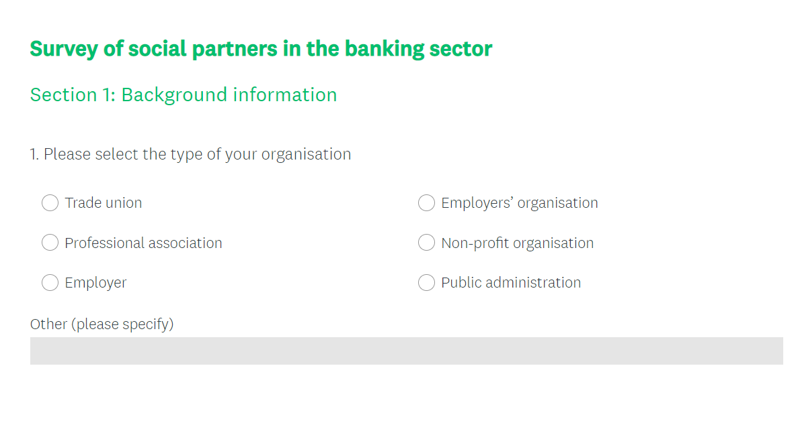
Survey of social partners
Time frame: March 2020 – December 2020
Aim: to map out perspectives and opinions of TUs, employer´s associations and public institutions on the impact of the MiFID II and digitalisation on organisational changes, skill management, working conditions in the banking sector
29 questions; in English
Dissemination: with support of project partners and via email addresses
https://www.surveymonkey.com/r/D5ZPPYC

Slide 6
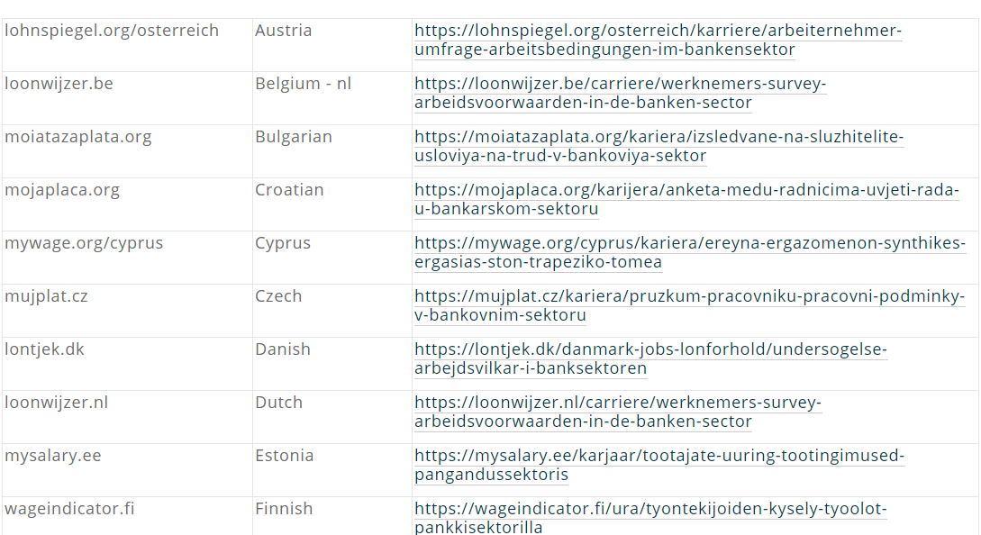
Survey of workers
Time frame: March 2020 – Dec 2020
22 language versions of the questionnaire (all EU languages)
27 EU member states + United Kingdom
WageIndicator

Slide 7
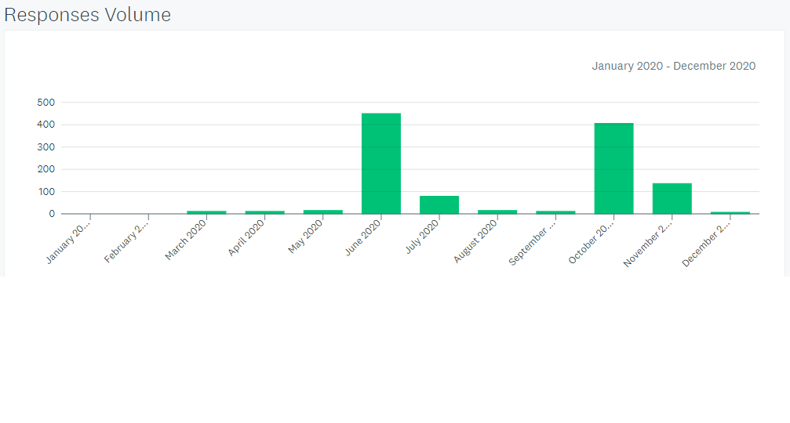
Survey of workers
Facebook campaign: sponsored posts in two waves (June 2020 and October 2020)
LinkedIn campaign: low response rate

Slide 8
Survey of workers in the banking sector structure of responses (1112)
Structure of responses | Responses
Gender (Q1)
Male | 359 | 32.00%
Female | 772 | 67.00%
Other | 4 | 0.30%
Mean length in working life in years (Q3) | 24
Mean length in working life in years in the banking sector (Q10) | 20
Level of education (Q2)
Upper secondary education | 220 | 20%
Post-secondary vocational education | 98 | 9%
Professional or tertiary education | 226 | 20%
University education | 540 | 48%
Trade union presence at the workplace (Q6)
Yes | 911 | 81%
No | 155 | 14%
I do not know | 59 | 5%
Trade union membership (Q7)
Yes | 649 | 57%
No | 437 | 39%
I do not know | 17 | 2%
Employment status (Q11)
Employee | 958 | 97.6%
Agency worker | 18 | 1.8%
Self-employed | 8 | 0.8%
Freelancer and contractor | 7 | 0.7%.

Slide 9
Survey of workers in the banking sector – structure of responses
Please select the country where you currently work (N=1112):
Finland | 16% | 177
Slovakia | 15% | 171
Spain | 14% | 151
Hungary | 11% | 119
Romania | 8% | 89
Italy | 8% | 88
Czechia | 5% | 58
France | 5% | 57
Greece | 3% | 32
Austria | 3% | 29
Other EU countries | 12% | 129
Other, non EU | 1% | 12

Slide 10
Survey of workers in the banking sector – main findings (selected)
Clarity of the MiFID II new skill requirements:
Very unclear and unclear (15%), slightly unclear (24%), clear (33%) very clear (15%), I do not know (11%)
(N=909)
Forms of trainings or other skill-upgrading support:
E-learning courses (724)
Guidelines or other learning materials (394)
Offline courses provided by the employer (344)
Offline courses provided by the external organization (190)
Peer-to-peer support (236)
None (32)
(N=904)

Slide 15
Please rate the level of stress at work (N=642):
Severe (58%), moderate (32%), Mild (8%) and none (1%)
What is the cause of your stress at the workplace? (N=627)
Volume of workload (77%)
Complexity of the allotted tasks (41%)
Frequent interruptions at work (41%)
Relationship with my manager (31%)
Introduction of new technological devices and applications (26%)
Relationships with the clients (17%)

Slide 17
Survey of social partners in the banking sector – structure of responses
Structure of responses | Responses
Type of organisation
Trade union | 24
Professional association | 2
Employer | 2
Employers’ organisation | 3
Position within organisation
Officer/Staff member | 10
Head/President | 5
Deputy-head/Vice-President | 3
Coordination for European/foreign affairs | 2
General Secretary | 1
Other | 10
Country in which organisation is established
Italy | 8 | Germany | 1
Finland | 3 | Ireland | 1
Austria | 2 | Netherlands | 1
Czech Republic | 2 | Portugal | 1
Slovakia | 2 | Romania | 1
Belgium | 1 | Spain | 1
Croatia | 1 | Slovenia | 1
France | 1 | United Kingdom | 1

Slide 18
The most frequently utilised forms of trainings or other skill-upgrading support:
E-learning courses (21)
Guidelines or other learning materials (8)
Offline courses provided by the employer (9)
Offline courses provided by the external organization (4)
Peer-to-peer support (8)
(N=23
The most effective forms of trainings or other skill-upgrading support:
E-learning courses (10)
Guidelines or other learning materials (7)
Offline courses provided by the employer (10)
Offline courses provided by the external organization (10)
Peer-to-peer support (12)
(N=23)

Slide 19
Please rate to what extent do you agree with the following statements (N=24)
 | Strongly disagree and disagree | Neutral | Strongly Agree and agree
Employees are provided with sufficient employer's support to adapt to new skill demands | 14 | 1 | 9
Trainings provided to employees adequately reflect the new skill requirements | 9 | 8 | 7
Employees have enough time to get prepared for mandatory tests | 10 | 2 | 6
Employees have enough time to upgrade their skills during their working time | 18 | 2 | 5
Employees are offered a feasible job rotation system, so their skills are used effectively | 13 | 8 | 1

Slide 20
Survey of workers in the banking sector – main findings
Please rate the relevance of the problems currently occurring in the banking sector/investment companies (N=24):
 | Very relevant and relevant | Moderately relevant | Slightly relevant | No relevant
Deteriorating working conditions | 14 | 3 | 4 | 2
Labour rights violations | 12 | 2 | 6 | 3
Weak position of the trade unions | 9 | 2 | 7 | 6
Poor adaptability to the new skill requirements | 10 | 11 | 0 | 2
Necessity to quickly adapt to digitalisation | 22 | 2 | 0 | 0

Slide 21
Survey of workers in the banking sector – main findings
Since the introduction of the MiFID II regulation in 2018, please rate to what extent (N=22):
 | To a great extent | Somewhat | Very little | Not at all
Workload has increased | 9 | 9 | 1 | 0
Overtime work has increased | 9 | 6 | 2 | 1
Level of stress has increased | 12 | 5 | 1 | 1
Statutory liabilities (financial penalties, disciplinary and criminal liabilities) on the worker´s side have increased | 5 | 7 | 0 | 3

Slide 22
THANK YOU FOR YOUR
ATTENTION!
lucia.kovacova@celsi.sk

