Slide 1

Bratislava, 5th March 2020
Proposals for the implementation of joint activities
between scientific partners and trade unions
Francesco Discanno FIRST CISL

Slide 2


Slide 3
Organisation and demand for labour
Job quality
Hybrid work

Slide 4
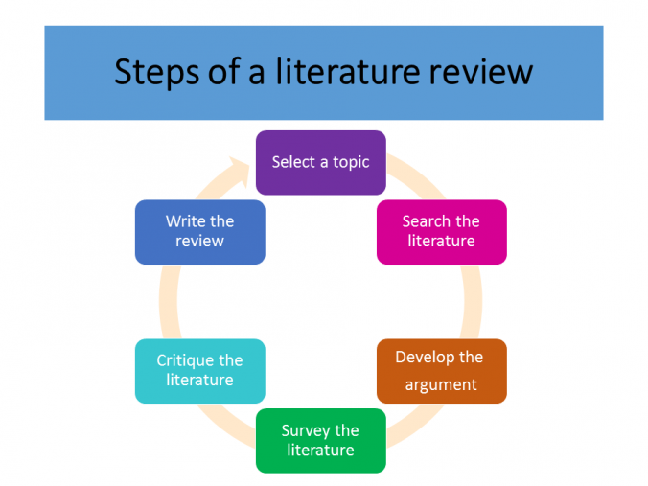

Slide 5
Survey 2 (ADAPT topic)
Survey 1 (CELSI topic)

Slide 6

MIFID II and digitisation:
organisational change
Survey 3.
Semi-structured interviews to social partners, facilitated by trade unionists.
Impact of change on labour demand and working conditions, with consequent needs of social dialogue.
CELSI

Slide 7
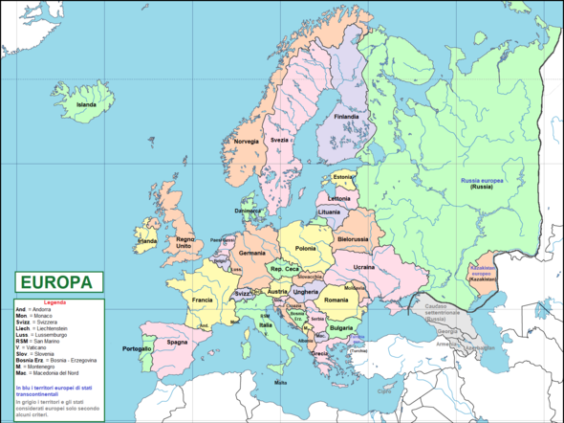
3 geographical areas, 4 country-specific case studies: at least 5 interviews for each country

Slide 8
Our first proposal concerning the task of the case studies-interviews:
CELSI is preparing an “interview guide”, which will be unified for all the 4 countries (although there will be some country-specific questions).
CELSI and FIOH already run some interviews in December 2019 to map out the topic (this was also helpful for designing the questionnaire relevant to Survey 1).
Since CELSI is able to conduct the interviews by the end of April 2020, we propose the scientific partners to accomplish the task around the 24th of April, so that they can report the first outcome during the next step in Dublin (29th April) .

Slide 9
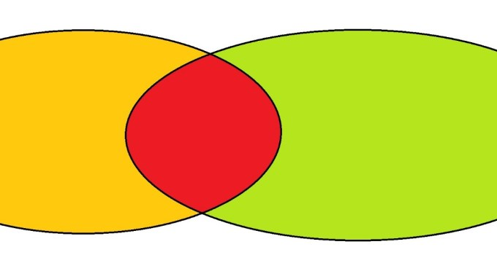
The three sets of activities concerning the project
research
experience

Slide 10
A crucial part of our project is the convergence of theoretical approaches and research findings carried out by the scientific partners - who observe the financial world from the outside - with the empirical evidence offered and shared by the unionists who are “immersed” in the financial world.
The integrated knowledge constructed in the research context can be translated and applied to the work context.
The outcome of the integrated knowledge will add value to the next on-field activities of union actors as they are agents of knowledge and change.

Slide 11
Qualitative and quantitative surveys
Policy recommendations

Slide 12

Qualitative and quantitative survey
Topic 1
Topic 2
Topic 3

Slide 13
The qualitative section of the survey aims to collect and work non-numerical data in order to get empirical evidence on changes concerning organisation and labour demand, job quality, employment relationships. Useful “good practices” about flexicurity and protection of workers can be drawn from the experience of people interviewed.
The quantitative section of the survey aims to collect and treat numerical data which are based on closed-ended questions about related topics. The number of observation units is large, in order to provide the “big picture” of the investigation.

Slide 14
Who is involved and how?
The three scientific partners will select the contents of the survey.
The trade unionists will set the sampling plan (choices about the samples such as which population, number of members, method of sampling) and manage the interviews in participating countries.
The “privileged witnesses” will be interviewed as expert observers (people whose opinion, based on professional expertise or technical skills, is able to deliver a clear empirical evidence).
The associate organisation WageIndicator will survey the impact of changes on workers in terms of stress & health.

Slide 15
The QCA methodology (qualitative comparative analysis) will be used for the examination and interpretation of results emerging from quali-quantitative surveys. QCA is a technique enabling the analysis of multiple cases in complex situations. It can help explain why change happens.
All the information collected will be synthesised and a QCA will be performed, also including the analysis of the points of strength and weakness (SW analysis) concerning the actions undertaken in the involved countries.
The results will be included in a Good Practice Report, addressed to the project partners, associated partners, the European Commission, relevant stakeholders. The report will include a section of Policy Recommendations.

Slide 16

Policy Recommendations are based on research findings and good practices that are consistent with the aim of the project.
The methodological path is the logical framework (problem tree and symmetric solution tree).

Slide 17
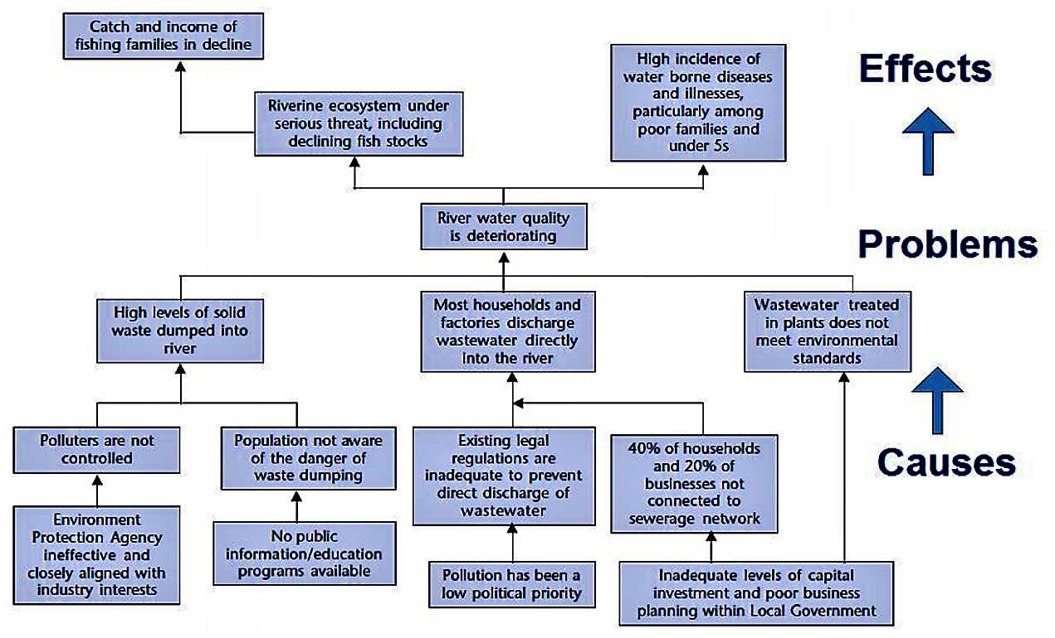
(European Commission, 2014)

Slide 18
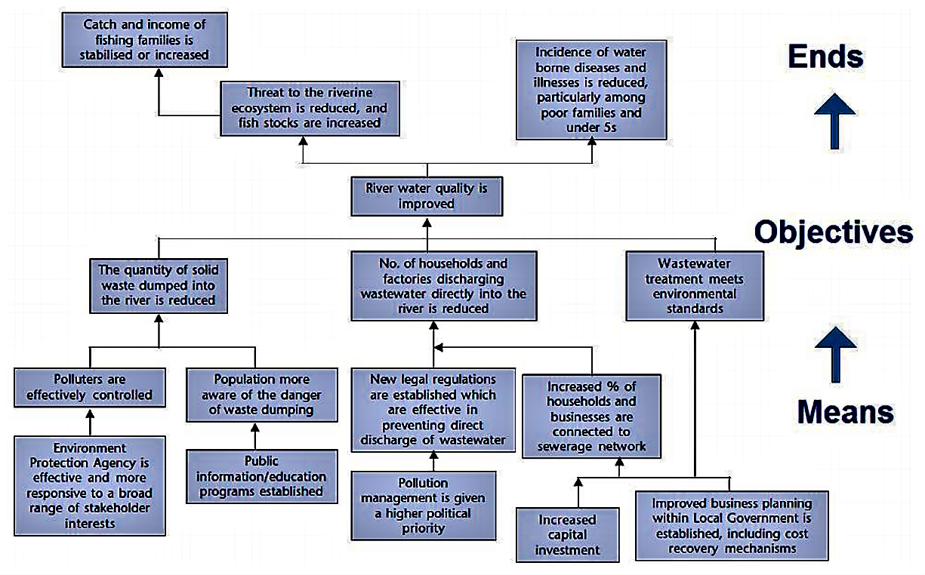
(European Commission, 2014)

Slide 19
Our second proposal concerning the joint activities:
According to the DWP, a Policy Recommendations hypothesis will be presented during the 29th April workshop in Dublin, based on the first outcome of research and empirical evidence.
A Policy Recommendations draft outline should be elaborated before the step in Dublin – around the 24th of April - to be submitted during that meeting.

Slide 20
Our third proposal concerning the contents of research (suggestions about specific investigation):
Why independent and non-independent advice can’t be performed by the same employee
What are the disciplinary and legal risks for the «shared» cross-selling?
Are employees aware that most banks record the communication about transactions (phone conversations, company chat and WA, email)? Can this be a driver of increased stress at work?
Are «hybrid» workers subject to an implicitly stronger commercial pressure during the half of the week when they are self-employed but economically dependent?

